Slide 1
CUDS
DEFINITIONS, THEIR USEFULNESS AND OTHER CONSIDERATIONS

Slide 2
CUDS
WE ARE ALL USING THE SAME WORDS {CUD, FULL CUD, RETAINED CUD} BUT IS THEIR MEANING THE SAME FOR ALL OF US?
THE ANSWER IS A RESOUNDING
NO

Slide 3
CUD Definition History
Pre-1969 most authors including Sheldon and Overton usually referred to cuds as rim breaks or defects
A major step forward was the publication of
THE DESIGN CUD by M Goodman in 1969
“An abnormally raised area of metal , on the field or design of a numismatic product, involving the edge of the die and caused by a broken die.”
“The term Retained Cud refers to a broken piece of the die that is still being held in place, or retained, by the collar although slightly depressed from the main section of the die.”

Slide 4
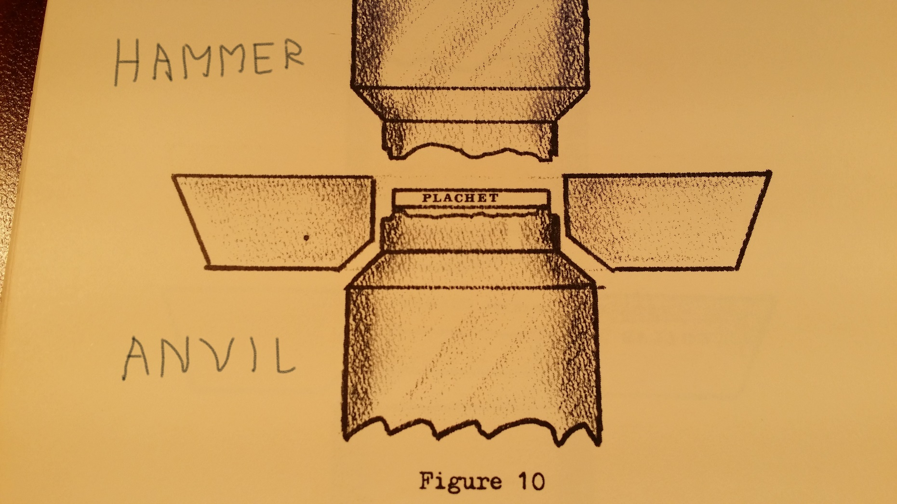
Planchet in Coining Chamber
Per Goodman

Slide 5
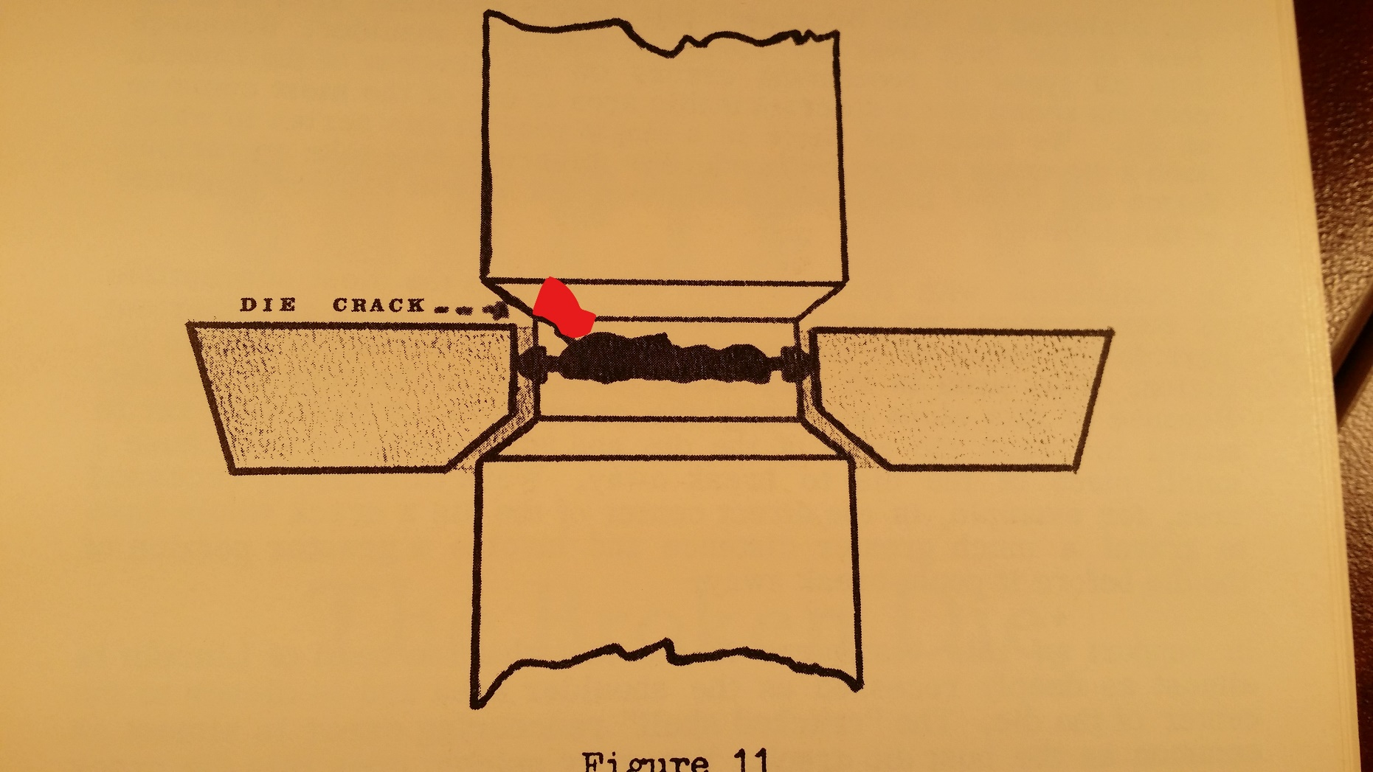
Die Crack Per Goodman

Slide 6
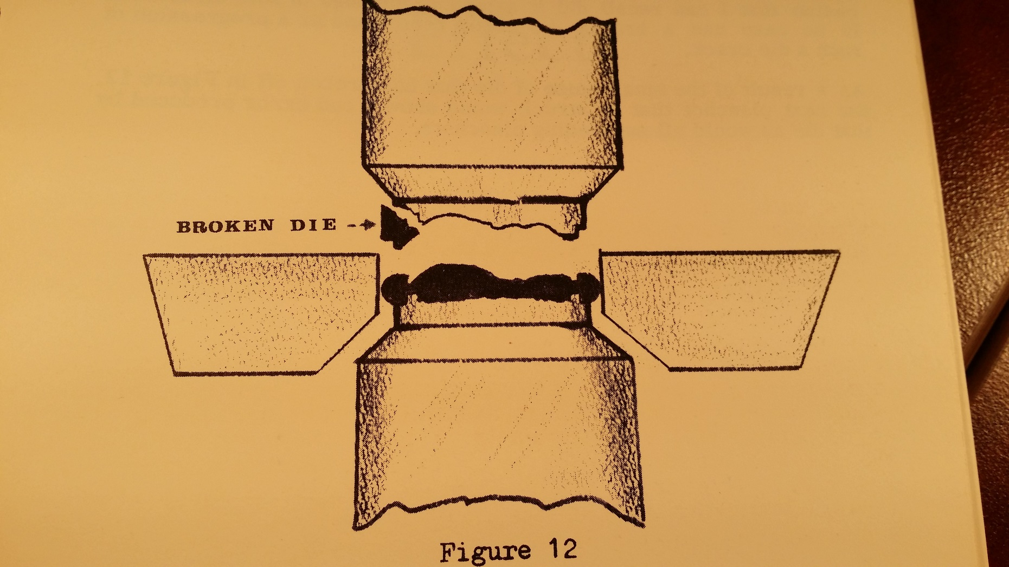
Broken Die Per Goodman

Slide 7
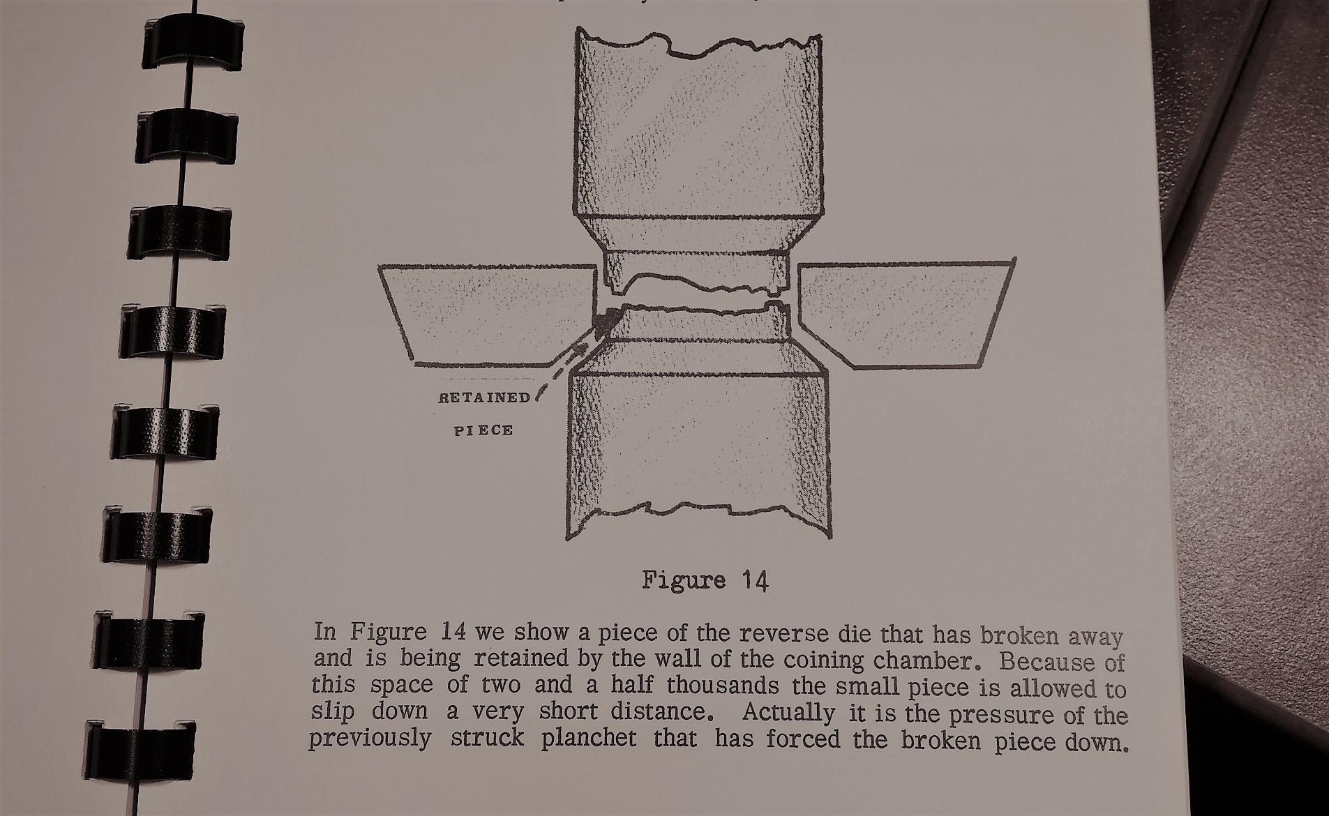
How a Retained Cud Occurs per Goodman

Slide 8
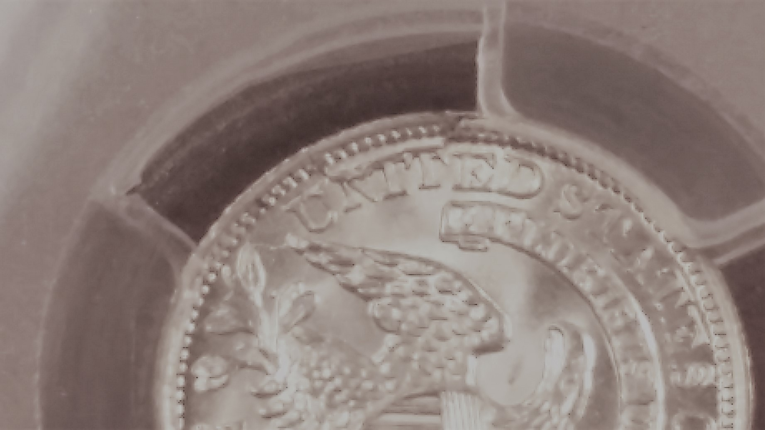
Retained Cud 1831 LM-1.3

Slide 9
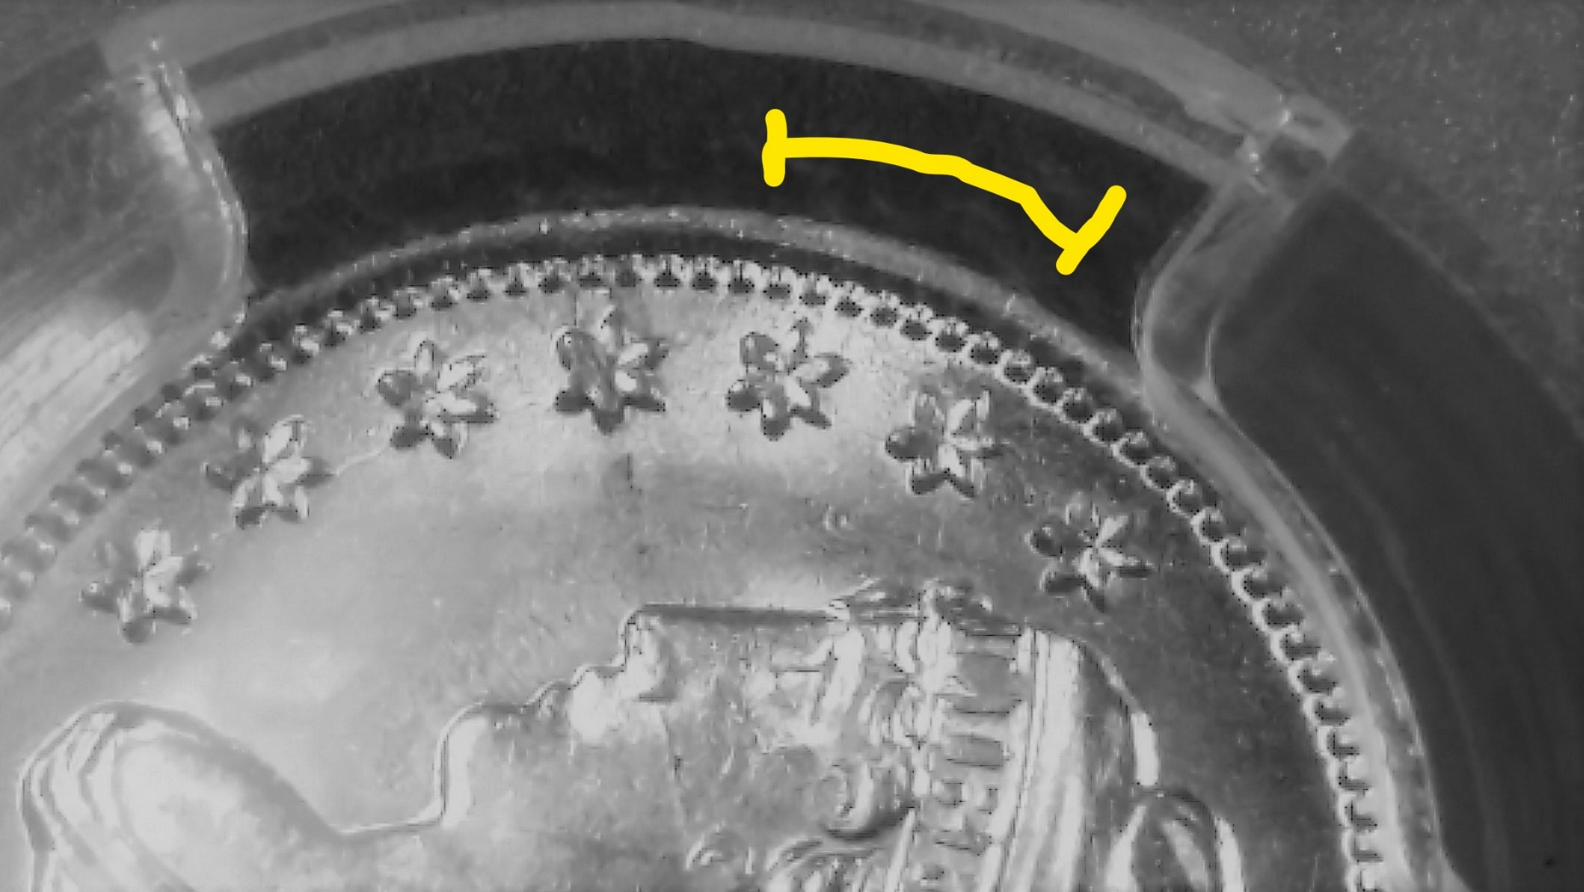
Obverse of 1831 LM-1.3 with Cud

Slide 10
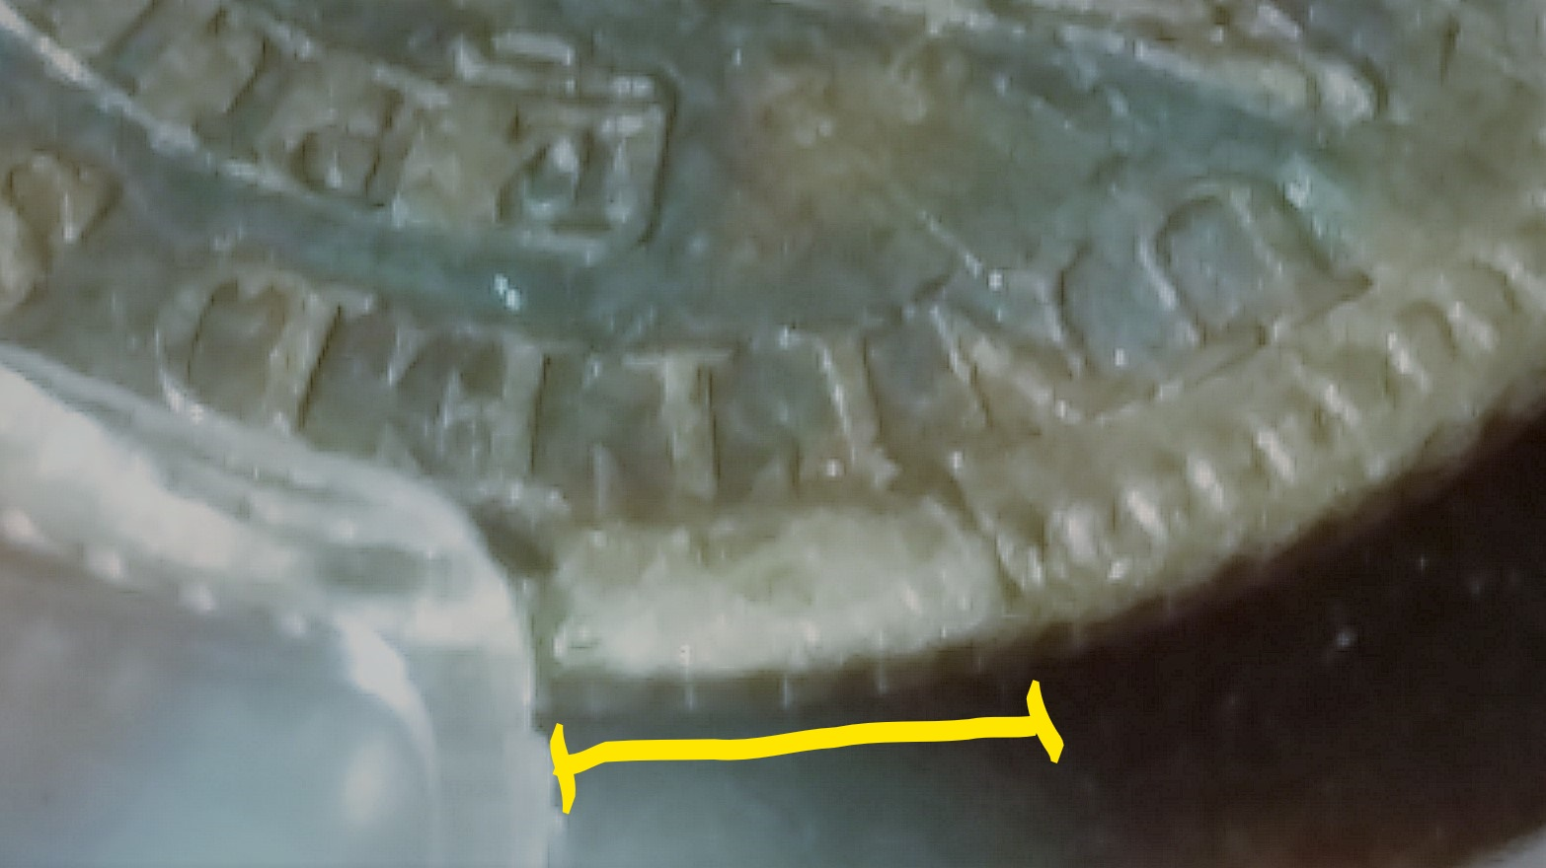
Full Cud 1829 LM-3 Reverse

Slide 11
Collar vs No Collar
Bust half dimes, dimes and quarters were struck in a coining press with a collar having a tight tolerance (2.5 thousandths of an inch), which was just slightly larger than the planchet, so reeding would result on the edge of the coin during striking
Bust half dollars were struck in an open collar coining press, but there was no intent to have reeding develop as these coins had been put through the Caistang machine to apply edge lettering and devices prior to striking.

Slide 12
Collar vs No Collar
Bust half dimes, dimes and quarters are likely to differ from bust half dollars in the character, frequency and commonness of cuds

Slide 13
Cuds - Obverse vs Reverse
Obverse dies were usually the “hammer” dies
Reverse dies were usually the “anvil” dies
Observations suggest:
Cuds are more common on the reverse of coins
Retained cuds are more common than full cuds

Slide 14
CUD Definition History
Pre-1969 most authors such as Sheldon referred to cuds as rim defects
A major step forward was publication of
THE DESIGN CUD by M Goodman in 1969
“An abnormally raised area of metal , on the field or design of a numismatic product, involving the edge of the die and caused by a broken die.”
“The term Retained Cud refers to a broken piece of the die that is still being held in place, or retained, by the collar although slightly depressed from the main section of the die.”

Slide 15
CUD Definition History
  Overton 1st & 2nd (1970) editions provide no cud definitions
OVERTON 3RD EDITION DEFINITION 1990
  …A die break is a larger or thicker line which also generally shows up as a raised area on the coins surface. Some breaks show up on the finished coin specimen as an entire raised area. This happens when the die is broken and the section slips. When the broken section of the die is dislodged from the main die it results in a cud or area where no die detail is reproduced on the finished coin specimen.(Emphasis added)
  1805 O-104a obverse is plated as an example of a cud.
  Overton’s 2nd edition describes this same coin as having “a heavy rim break from stars 9 to 12”

Slide 16
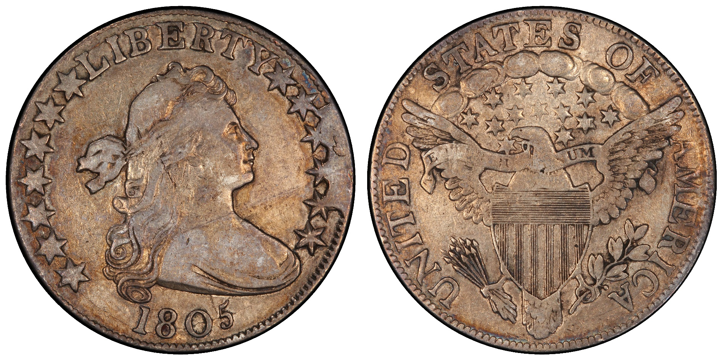
1805 O-104A with Obverse Cud
Photo taken off PCGS website

Slide 17
CUD Definition History
Davis et al Early US Dimes 1984, Appendix F Die Deterioration
“…Once a crack has started (usually near the periphery), it frequently joins an adjacent crack which may cause a piece of the die to become dislodged. When this happens, the affected area will be raised on the coin’s surface; this is classified as a cud. If the loose piece should become completely dislodged from the die and no impression made on the planchet, it becomes a full cud. In either case, a weakness of strike is usually observed on the opposite side of the coin. Because the cud portion of the coin is raised, it is vulnerable to wear, and any detail will soon wear away, giving the appearance of a full cud.”

Slide 18
CUD Definition History
Logan McCloskey Half Dime DEFINITION 1998
“Partial and Full Die Cuds
As die cracks expand around the of a periphery die, they extended deeper and deeper into the die’s surface. When this happens, a crevice is formed in the working die permitting a fissure of silver to form on the coin during the strike. This raised fissure of metal is frequently the highest surface and the first location to wear.
If the working die was not immediately retired, the die crack may have continued to expand until a portion of the die became loose. When this happened, the loose piece was forced below the surface of the (anvil) die by the action of the screw press, thus becoming a raised portion on the coin. This is known as a partial cud and is weakly struck. A full cud occurs on a coin after the loose die piece breaks away and allows the flan to expand without restriction.”
However, the authors never used the term partial cud to describe any die marriage, but did use the terms full cud and retained cud.

Slide 19
Full Cud 1829 LM-3 Reverse

Slide 20
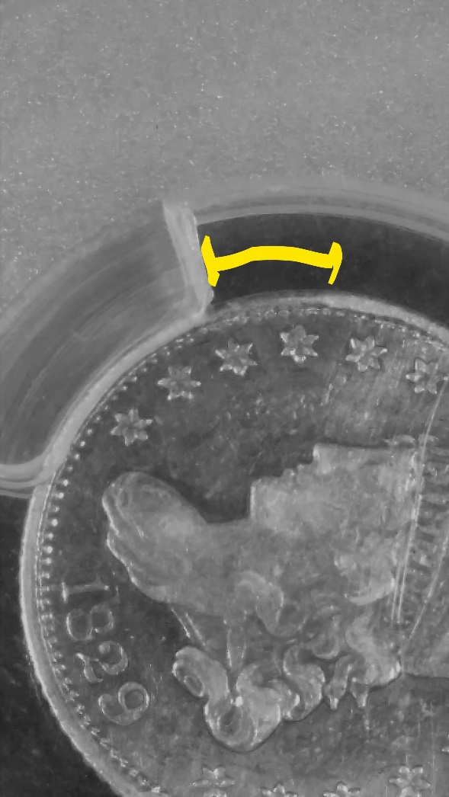
Obverse of 1829 LM-3 with Cud

Slide 21
What are Die Stages ?
Thompkins in Early US Quarters 1796-1838 in a section titled “DIE STAGES” states:
As different characteristics develop during the striking of subsequent coins (such as die cracks, die breaks, cuds, die clashes and general die deteriorations etc.) the die is at different points of a particular stage in its life. While some of these stages last for a long time, others are fleeting and may rapidly advance to another stage. Consequently, EVERY COIN STRUCK MAY CONSTITUTE A DIFFERENT OR UNIQUE STAGE OR MULTIPLE COINS STRUCK MAY SHOW THE SAME PARTICULAR DIE STAGE.
To make an accurate assessment of where to place a coin in any die stage progression, the coin must be in a grade of extra-fine or above otherwise knowing where it lies is at best a guess.
Tompkins in Early US Half Dollars 1794-1807 Volume 1 in a section titled “DIE STAGES” uses very similar language as in his early quarter book

Slide 22
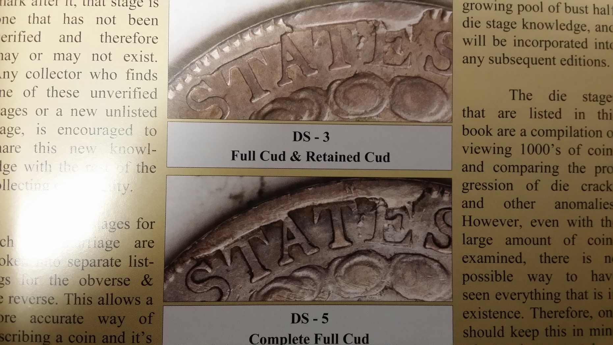
Cud Pictures from Tompkins

Slide 23
CUD JF Definition
Full cud: An abnormally raised area of metal on the field and/or design involving the edge of the die, with no detectable detail present (i.e., letters, stars, etc.) caused by a missing piece from a broken die. Note the entire area of the cud need not be raised to the height of the rim or above it if the cud is large enough, but the entire area must be above the height of the entire adjacent field of the coin, although it may only reach the height of the rim where it abuts the rim.
Retained cud: An abnormally raised area of metal within an area contained between die cracks and/or other design elements (i.e., letters) and/or the rim AND this area must be raised above all adjacent field areas, but not necessarily up to or above the height of the rim.

Slide 24
CUD JF Definition
Internal cud: An abnormally raised area of metal within an area contained between die cracks and/or design elements but not the rim, where this area is raised above all adjacent areas.
Incomplete cud: An abnormally raised area of metal within an area contained between die cracks and/or other design elements and/or the rim but only a portion of the contained area is raised above the adjacent field areas and/or the rim.

Slide 25
CUDS - SUBTYPES
FULL
RETAINED
INCOMPLETE

Slide 26
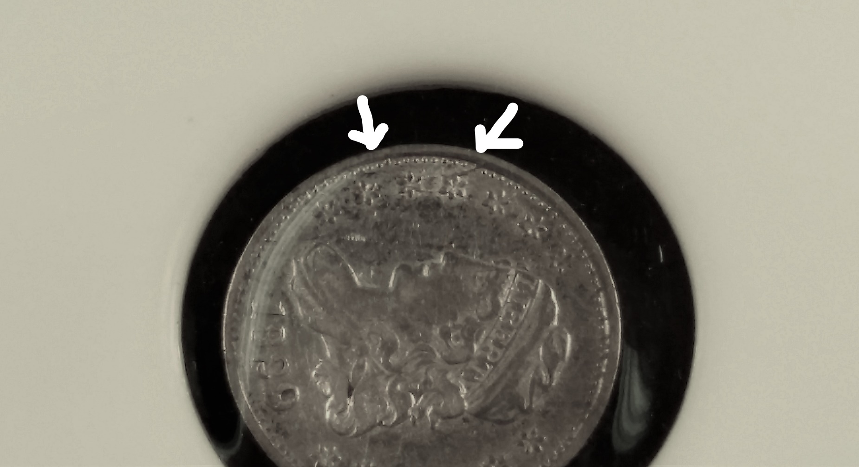
1829 LM-18 Incomplete Cud
Note a raised area of the field is only present near the right arrow

Slide 27
CUD Definition
Davis et al Early US Dimes 1984, Appendix F Die Deterioration
“…Once a crack has started (usually near the periphery), it frequently joins an adjacent crack which may cause a piece of the die to become dislodged. When this happens, the affected area will be raised on the coin’s surface; this is classified as a cud. If the loose piece should become completely dislodged from the die and no impression made on the planchet, it becomes a full cud. In either case, a weakness of strike is usually observed on the opposite side of the coin. Because the cud portion of the coin is raised, it is vulnerable to wear, and any detail will soon wear away, giving the appearance of a full cud.”

Slide 28
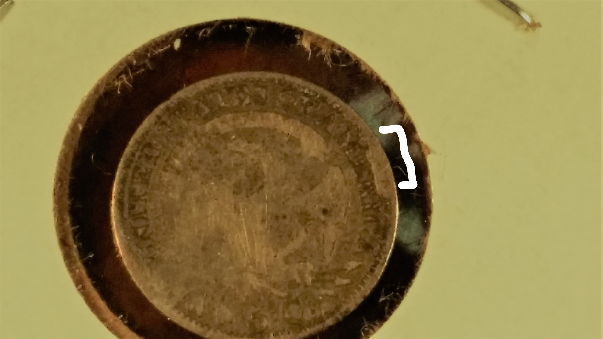
? Full Cud 1829 LM-7.3 ?

Slide 29
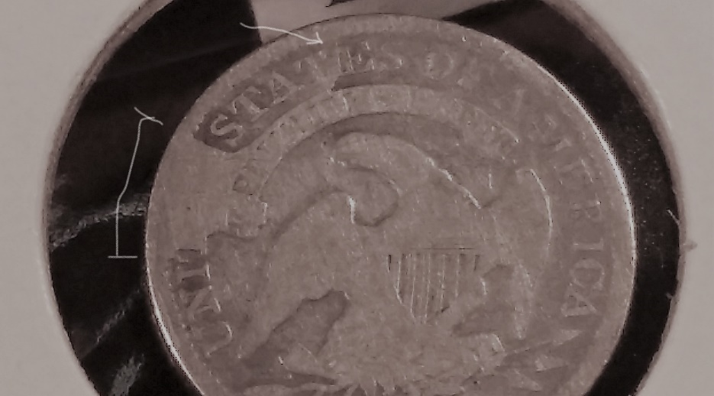
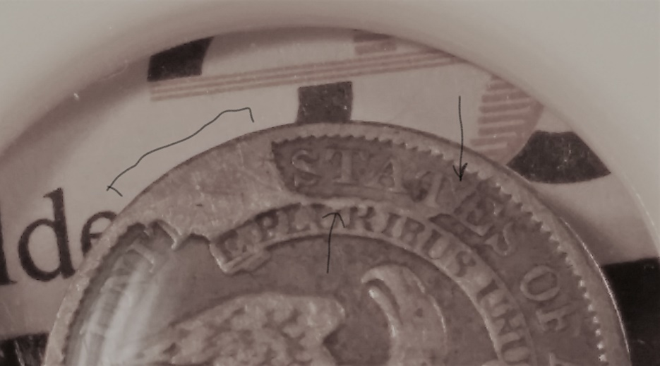
Comparison 1835 LM-9.2 vs 1836 LM-1.2
1835 LM-9.2
1836 LM-1.2
Both coins “appear” to be full cuds at first glance, but one can see a more prominent second retained cud and a new strong break along the scroll on the LM-1.2; we also know the LM-1.2 was struck after the LM-9.2 and the LM-1.2 almost always appears to have only retained cuds.
I do not know if this 1836 LM-1.2 has a full cud of not.

Slide 30
CUDS
SO………………….
WHAT DO WE KNOW NOW?

Slide 31
CUDS
Definitions can aid in accurately communicating information , but may be inadequate to truly describe a specific coin
  High grade coins allow distinguishing cud types
  Low grade coins may not permit identification of cud types
All full cud definitions (I have seen) required the coin’s edge to be included
Authors of books on John Reich designed coins have not consistently used the same definitions of cuds and their subtypes

Slide 32
CUDS
Observations requiring further study
Commonness of cuds on coin reverses versus obverses as this varies by denomination
Locations of cuds on coin reverses and obverses varies by denomination
Some cuds can be found as multiple subtypes (full, retained and incomplete) while others cannot
Rarity of cuds and their different die stages

Slide 33
“Cuds are hard.”
Questions ?
Comments ?

